Slide 1
ITMD 536 Software Testing & Maintenance
Chapter 5 and 6 Adequate Transition
&
Establishing Infrastructure

Slide 2
Objectives
What are the prerequisites for success?
What do you need for effective maintenance program?
What happens when a system does not transition?
When do you replace rather than repair?

Slide 3
Objectives
What is best practice?
What are the roles of Capability Maturity Model (CMM) and Capability Maturity Model Integration (CMMi)?
What is the role of requirements?
How can you do budgeting and estimating?
What is release management?
What is Reuse, Rejuvenation and Resuscitation?

Slide 4
Objectives
What Event/Request Management KPA?
What Management Planning?
What is Monitoring and Control?
What is SLA and Supplier Agreement Management? (SMM)

Slide 5
Objectives
What is Predelivery and Transition services?
What is Operational support services?
What are the Evolution and correction services?
What is Verification and a Validation? (SMM)

Slide 6
5. Adequate Transition and Turnover Planning
Transition: The process employed to transfer the software and responsibility for its maintenance and support from the developer to the maintainer.

Slide 7
5. Adequate Transition and Turnover Planning
Turnover: The point in the life cycle when the software and responsibility for its maintenance and support are transfer to occur, all terms and conditions spelled out in the transfer agreement must be satisfied (or waived).

Slide 8
5.1 Prerequisites for Success
Planning for transition and turnover of responsibility from development to maintenance shops should be conducted early in the development life cycle.
Working groups should be formed to engage all organizations involved as requirements are being formulated.

Slide 9
5.1 Prerequisites for Success
Process planning provides the process infrastructures used by the workforce to ensure that both products delivered for software maintenance satisfy the standards. (versions, naming conventions used for configuration baseline and sequences.)

Slide 10
5.1 Prerequisites for Success
Human resource planning puts the skilled people in place when they are needed during and after the transition.
Project planning provides the entry/exit checklists required to ensure the developers deliver. (also verifies equipment, facilities, tools and people are ready and trained)

Slide 11
5.2 What you need to Execute an Effective Maintenance Program
Tools like checklists help because they act as reminders of things that you should not forget to do.
Track events and follow-up during the move to make sure things go as planned.
Get ready for transition and turn the software maintenance responsibility and to execute the plans.

Slide 12
5.2.1 During Development
The primary focus is almost always on development, and maintenance is a secondary consideration at best.
Regression test baseline and set of tests revalidates the software once it is changed and this makes maintenance job easier.

Slide 13
5.2.1.1 Product
Well structured architecture is software’s building block, it can be added, modified, and removed with the little impact on overall functionality and performance.
Techniques like object-oriented design, systematic reuse, and product line architectures preserve structure and help maintain the integrity of the product, its components and its databases.

Slide 14
5.2.1.2 Process
IBM Rational Unified Process (RUP) where transition is identified and formal stage of the development life cycle.
Other life-cycle models, both waterfall and incremental, have delivery of software to systems testing and acceptance testing as their last phase.

Slide 15
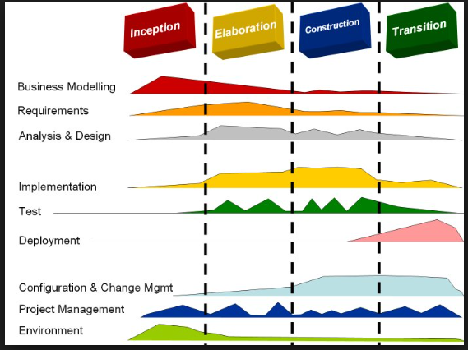

Slide 16
5.2.1.2 Process
Deploy plan
Develop support materials
Manage acceptance test
Enable product deployment unit
Manage acceptance test for custom installation
Package product
Provide access to customer site

Slide 17
5.2.1.2 Process
Calling out the transition phase with distinct processes and a culminating product release milestone provide a clear path for an orderly transition and turnover to maintenance.

Slide 18
5.2.1.3 People
To succeed you need a skilled, knowledgeable, able, experienced, and motivated workforce is needed to use these processes and architecture to perform the maintenance work.
Maintenance workforces are typically better skilled and more experienced than their development counterparts.

Slide 19
5.2.1.4 Project
The software maintenance plan is the primary document that needs to be generated. It is a blueprint for action as you transition responsibility to manage the generation of future software releases and versions from one group to another.
This document provides strategies, responsibilities, and plans for both transition and maintenance.

Slide 20
5.2.1.4 Project
Project also identifies the resources and schedules needed for critical tasks and events to succeed.
It also calls out milestones like the operational readiness review and establishes approaches for dealing with contingencies should bad things happen and delays occur.

Slide 21
Maintenance Plan Outline
1. Introduction
2. Scope
2.1 Product
2.2 Documentation
2.3 Relationships to Other Agencies/Projects
3. Strategies
3.1 Transition and Transfer
3.2 Operational

Slide 22
Maintenance Plan Outline
4. Transition Schedules, Tasks, and Activities
4.1 Installation
4.2 Initial Operations
4.3 Training
4.4 Conversion and Data Migration
4.5 Transition Schedule
4.6 Outstanding Issues

Slide 23
Maintenance Plan Outline
5. Maintenance Schedules, Tasks and Activities
5.1 Release Process
5.2 Performance Measures and Reporting
5.3 Governance and Management Approach

Slide 24
Maintenance Plan Outline
5.4 Problem Resolution
5.5 Documentation Strategies
5.6 Training
5.7 Sustainability Measures
5.8 Maintenance Schedule
5.9 Outstanding Issues

Slide 25
Maintenance Plan Outline
6. Resource Requirements
6.1 Software Resources
6.2 Hardware Resources
6.3 Facilities
6.4 Personnel
6.5 Other
7. Acceptance Criteria
8. Management Controls

Slide 26
Maintenance Plan Outline
9. Reporting Procedures
10. Risks and Contingencies
11. Team Information
12. Review Process
13. Configuration and Distribution Control
14. Plan Approval

Slide 27
Software Operational Readiness Checklist
□ The installation has been coordinated with the system owner, operations staff, support staff, and other affected organization.
□ All necessary modifications to the physical installation environment are complete.
□ The hardware has been inventoried and tested.
□ User training has been completed.

Slide 28
Software Operational Readiness Checklist
□ Software has been installed on the hardware and acceptance testing has been successful repeated to your staff.
□ A copy of installation tests has been placed in the project file.
□ All acceptance tests have been coordinated with the system owner, users, operations staff, support staff, and other affected organizations.

Slide 29
Software Operational Readiness Checklist
□ The test environment and regression test baseline have been placed under configuration management.
□ All tests have been executed correctly.
□ Any tests that failed have been documented, corrected, and retested.
□ A copy of all acceptance test materials have been conducted and a physical configuration audit successfully completed.

Slide 30
Software Operational Readiness Checklist
□ Complete operating documentation describing the release has been approved and delivered.
□ The software release has transitioned to full operational status and has been transferred to the life-cycle support staff for further maintenance actions.
□ All training and certification activities have been successfully completed.

Slide 31
Software Operational Readiness Checklist
□ For major software systems involving multiple organization and interfaces with other systems, a formal announcement of transition and transfer has been made.
□ A list of open issues and planned enhancements has been provided to the maintenance staff.

Slide 32
Software Operational Readiness Checklist
□ Access rules have been modified to provide access to the maintenance staff and to remove the project team from access to the release.
□ Software, files and other support software have been placed in the production library and deleted from the test library, as appropriate.

Slide 33
Software Operational Readiness Checklist
□ All files, operating documents, and other pertinent records have been turned over to the maintenance staff.

Slide 34
5.2.2 After Transition and Turnover
During the first year of operations the maintenance shop tries to stabilize the product and the software environment that it will use to update it.
Key differences between development and update environment and root cause are listed here:

Slide 35
Development versus Update Environment
Development Environment:
Emphasis for use is placed on design and development tasks (coding, unit checkout, and test)
Update Environment:
Emphasis for a use is placed on execution, update, and performance enhancement.
Root Cause of Differences
Different work gets accomplished during two phases: development implements product and maintenance updates/refines it

Slide 36
Development versus Update Environment
2. Development Environment:
Current operational platform (operating system, database managers, etc.)
Update Environment:
Current operational platform plus variants.
Root Cause of Differences:
Multiple platform configurations are maintained for different field sites (different versions of software etc.)

Slide 37
Development versus Update Environment
3.Development Environment:
Pseudo-operational equipment.
Update Environment:
Actual operational equipment.
Root Cause of Differences:
Operational equipment may not be available to developers because it is either being developed or needed in the field (limited availability).

Slide 38
Development versus Update Environment
4. Development Environment:
Rich and capable development toolset.
Update Environment:
Not so rich and capable toolset.
Root Cause of Differences:
Tools used during development may be either expensive or proprietary. In addition, tools needed differ between phases because work done differs.

Slide 39
Development versus Update Environment
5. Development Environment:
User representatives.
Update Environment:
Actual users.
Root Cause of Differences:
Timing and availability may be such that users are not available during development.

Slide 40
Development versus Update Environment
6. Development Environment:
Field support requirement.
Update Environment:
Not applicable.
Root Cause of Differences:
May have to go to field sites in order to make repairs and install updates because users do not have this ability.

Slide 41
Development versus Update Environment
7. Development Environment:
Self-contained configuration.
Update Environment:
Links to sites worldwide if permissible (security may constrain this option).
Root Cause of Differences:
Need to download operational configurations automatically and install them in the field.

Slide 42
Development versus Update Environment
8. Development Environment:
Highly available for development and testing.
Update Environment:
Limited availability during operations.
Root Cause of Differences:
Due to operational and user demands for raining, the update environment may have limited availability during prime shifts for checkout and testing.

Slide 43
5.2.2 After Transition and Turnover
Release cycles during software maintenance are frequently tied to business cycles (i.e., annual or biannual).

Slide 44
5.3 What Happens When a System Does Not Transition
Those who develop the software have to maintain it, they often do a better job during development.
The total life-cycle cost will be less if it is maintained by the same development group.
There are many reasons for transition to a third party.

Slide 45
5.3 What Happens When a System Does Not Transition
Do not have staff available to work both development and maintenance tasks.
The software maintenance work is outsourced because rates are cheaper due mainly to lower burden rates.
Wages in China, India, and other countries compete for maintenance businesses.

Slide 46
5.4 When To Replace Rather Than Repair
The cost of maintaining obsolete equipment and platforms may be so high that replacement is the only option.
Replacing hardware may force replacing software.
Windows Xp, Windows Vista etc.

Slide 47
5.4 When To Replace Rather Than Repair
Retiring software under any circumstance is hard because people are averse to getting rid of anything that they are comfortable with and that works.
Replacing hardware and software replacements can be viewed as opportunities rather than challenges.

Slide 48
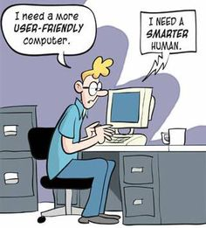

Slide 49
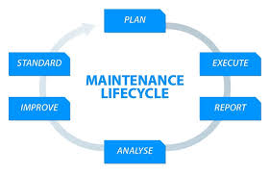

Slide 50
5. Event/Request Management Domain
This process domain covers four KPAs:
Event/Request Management
Maintenance Planning
Maintenance Request/Software Monitoring and Control
SLA and Supplier Agreement Management (SMM)

Slide 51
Event/Request Management Domain
1. Event/Request Management:
This is the entry point, through the help desk, for daily communication with the users.
The goal of this KPA is to ensure that the software maintenance process/services meet the agreed upon SLA quality/service objectives.

Slide 52
Expected Results from Event/Request Management KPA
The maintenance work performed is centered on customer/user priorities.
The interruptions in ongoing work are justified according to the terms of the SLA and agreed on with the customers.
The maintenance organizational unit meets its levels of service.

Slide 53
Expected Results from Event/Request Management KPA
An active monitoring approach, for rapid reactions, is being implemented.
Information on failure and maintenance activities that affect the customer is quickly circulated.

Slide 54
2. Maintenance Planning
The maintenance planning KPA helps to plan the allocation of resources to individual requests and to handle rapidly changing priorities.
It handles requests from:
Customers and users
Development teams
Subcontractors, and
Computer operations

Slide 55
Expected Results from Maintenance Planning
A sound forecast is available on needed resources in software maintenance (strategic plan, tactical plan, and operational plan).
SLA, agreement, license, and contract renewals are planned.
The failure/recovery tests are planned for each software in maintenance.

Slide 56
Expected Results from Maintenance Planning
Requests are allocated to future versions of the software.
Software upgrades are planned.
Predelivery and transition services are planned.
There is an optimal allocation of maintenance resources to work items.

Slide 57
Expected Results from Maintenance Planning
Software maintenance has a plan, and this plan is communicated and approved.
The stakeholders are informed about the plans.

Slide 58
Maintenance Request Software Monitoring and Control
This identifies items of such that need to be controlled and the individual work items assigned to the resources that are currently in progress.

Slide 59
Maintenance Request Software Monitoring and Control
Maintainers must proactively monitor the gaps in service levels, make needed adjustments, and receive/establish new agreements for delivery or service levels when needed.

Slide 60
Expected Results from Maintenance Request/Software Monitoring and Control
Maintenance activities are performed according to forecasts from the various levels of maintenance planning.
Maintenance work items, costs, and respect for commitments are tracked.
Activities are reviewed and replanned when they progress differently from what was originally planned.

Slide 61
Expected Results from Maintenance Request/Software Monitoring and Control
Responsibility for communication of rectifications, commitments, and promises is known by the resources.
Reviews are conducted with the customers at main checkpoints to examine the results and plans, and also the progress of work.

Slide 62
Expected Results from Maintenance Request/Software Monitoring and Control
Corrective actions are taken if it is determined that there is a different between results and the forecasting accepted by customers.

Slide 63
SLA and Supplier Agreement Management
The SLA and Supplier Agreement Management KPA identifies the levels of services and resource requirements, and negotiates prices with customers and service partners.

Slide 64
SLA and Supplier Agreement Management
A. The number of maintenance services that have to be delivered.
B. The cost of each service.
C. The quality and efficiency of the products and services, and
D. The establishment of standardize measures for performance measurement and reporting customers.

Slide 65
Expected Results from SLA and Supplier Agreement Management
The agreements are defined, formalized, and negotiated.
The agreements and responsibilities are defined.
The SLAs are expressed in words that are easily understood by the customer.
A communication channel exists, is used and works to ensure agreements are performing well.

Slide 66
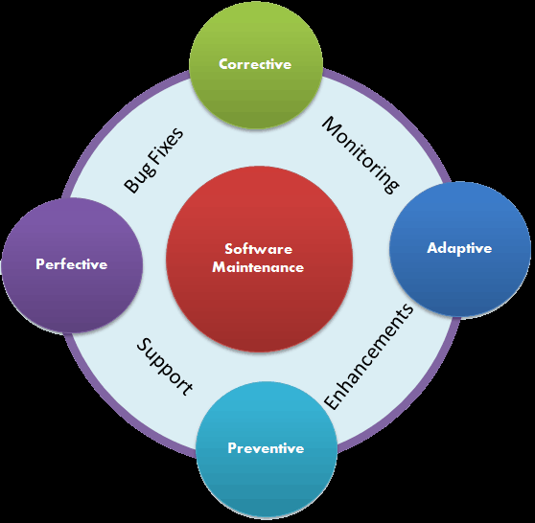

Slide 67
6 Establishing a Solid Management Infrastructure
Management: Getting things done through the work of other people.
Infrastructure: Underlying framework of an organization or system, including organizational structures, policies, standards, training, facilities, and tools, which supports its ongoing performance.

Slide 68
6.1 Best Practices
Maintenance Characteristics:
They invest in standard processes for work tasks that every project, large or small, has to perform.
They provide the needed amplifying procedures, practices, instructions, guidelines, and work-related aides to enact the processes.

Slide 69
6.1 Best Practices
Senior management in these shops commits to using these processes and acts as champions for their use and improvement.
Those doing the work in these shops approve of these processes and are trained to use them prior to their enactment.

Slide 70
6.1 Best Practices
Processes are enforced, but not in an overbearing and capacious manner (e.g., the process police come after you).
Process is viewed as important, but so were product and people. All the three receive the attention they deserve, as does the implementation of tried and true project management principles and techniques.

Slide 71
6.2. Role of Capability Maturity Model (CMM) an Capability Maturity Model Integration (CMMi)
ISO 9000 and CMMi can help simplify the job of software maintenance.
The CMMi includes three constellations, in recognition of the need for different practices to meet the needs of organizations development, services and acquisition.

Slide 72
Best Maintenance Practices by Key Process Area
1. Category: Engineering
Process Area: Product Integration
Best Practices for Software Maintenance:
Practice 1: Build sustainable release during development by focusing on evolutionary architectures and design.

Slide 73
Best Maintenance Practices by Key Process Area
1. Category: Engineering
2. Process Area: Requirement Development
Best Practices for Software Maintenance:
Practice 2: Generate requirements for maintenance release using some form of engineering change requests or trouble reports as your basis, not specifications.

Slide 74
Best Maintenance Practices by Key Process Area
1. Category: Engineering
3. Process Area: Technical Solution
Best Practices for Software Maintenance:
Practice 3: Capture implementation knowledge as new maintenance releases are developed, qualified, and fielded.
Practice 4: Reengineering poor-quality and poorly performing portions of the software as new maintenance releases are developed, qualified and fielded.

Slide 75
Best Maintenance Practices by Key Process Area
1. Category: Engineering
4. Process Area: Validation
Best Practices for Software Maintenance:
Practice 5: Conduct an operational readiness review and physical configuration audit to ensure that you can generate the release in the maintenance facility and it will work as intended in its operational environment.

Slide 76
Best Maintenance Practices by Key Process Area
1. Category: Engineering
5. Process Area: Verification
Best Practices for Software Maintenance:
Practice 6: Conduct an operational acceptance review and audit on-site in the field to ensure that the release satisfies its requirements and satisfies customer expectations.

Slide 77
Best Maintenance Practices by Key Process Area
1. Category: Engineering
6. Process Area: Emergency Solution
Best Practices for Software Maintenance:
Practice 7: Develop an emergency procedure under which solutions can be developed, tested, and distributed to the field quickly while preserving their configuration integrity.

Slide 78
Best Maintenance Practices by Key Process Area
Practice 8: Develop an acceptable procedure for installing and managing patches made in the field to implement emergency repairs.

Slide 79
Best Maintenance Practices by Key Process Area
1. Category: Engineering
7. Process Area: Test Management
Best Practices for Software Maintenance:
Practice 9: Develop a regression test baseline for use in revalidating the release once changes have been made to it.

Slide 80
Best Maintenance Practices by Key Process Area
2. Category: Project Management
1. Process Area: Integrated Product Management
Best Practices for Software Maintenance:
Practice 10: Establish a working group to engage all stakeholders, including the maintainer, customer, and user, in developmental decisions impacting operations and maintenance of the software in the field.

Slide 81
Best Maintenance Practices by Key Process Area
2. Category: Project Management
2. Process Area: Project Monitoring and Control
Best Practices for Software Maintenance:
Practice 11: Establish procedures to monitor technical work being done on the release so that corrective actions can be taken when discovered in a timely manner.

Slide 82
Best Maintenance Practices by Key Process Area
2. Category: Project Management
3. Process Area: Project Planning
Best Practices for Software Maintenance:
Practice 12: Ensure that project plans address transition and turnover of responsibility for the software from software development to maintenance.
Practice 13: Ensure that project plan templates address the release process during maintenance and related concerns.

Slide 83
Best Maintenance Practices by Key Process Area
2. Category: Project Management
4. Process Area: Requirements Management
Best Practices for Software Maintenance:
Practice 14: Maintain traceability of approved maintenance changes and fixes to release requirements.
Practice 15: Maintain traceability of release requirements to regression and qualification tests

Slide 84
Best Maintenance Practices by Key Process Area
2. Category: Project Management
5. Process Area: Quantitative Project Management
Best Practices for Software Maintenance:
Practice 16: Capture measurement data on software cost, schedule, productivity, quality, and process performance as the release is being generated, and use the data to manage the project quantitatively.

Slide 85
Best Maintenance Practices by Key Process Area
2. Category: Project Management
6. Process Area: Risk Management
Best Practices for Software Maintenance:
Practice 17: Institute risk management procedures to proactively identify, prioritize, and mitigate risks in timely manner using information provided during software maintenance by projects developed for that purpose.

Slide 86
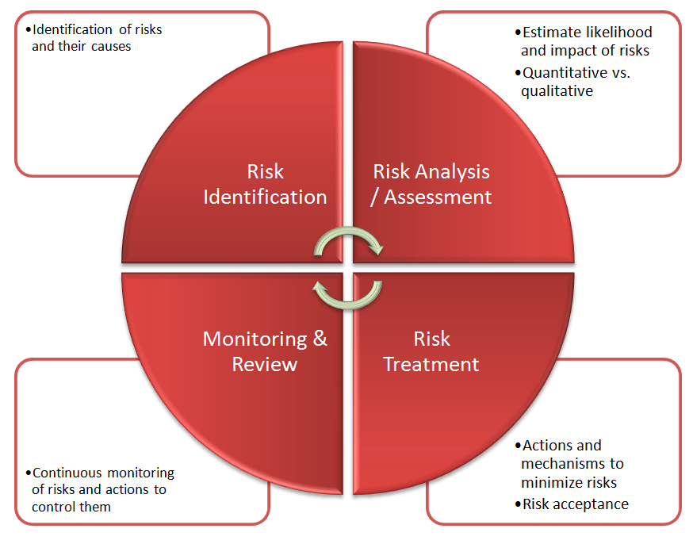

Slide 87
Best Maintenance Practices by Key Process Area
2. Category: Project Management
7. Process Area: Supplier Agreement Management
Best Practices for Software Maintenance:
Practice 18: Establish a market watch function for commercial-off the shelf (COTS) to keep current on available alternatives for packages used as part of maintenance releases being distributed to the filed.

Slide 88
Best Maintenance Practices by Key Process Area
Practice 19: Use relationship managers to influence the direction key suppliers take in the future with products and services used in maintenance releases.
Practice 20: Tailor development processes so they can be used during maintenance to manage suppliers developing software for releases.

Slide 89
Best Maintenance Practices by Key Process Area
2. Category: Project Management
8. Process Area: Facilities Management
Best Practices for Software Maintenance:
Practice 21: Readying facilities for software maintenance is a long-lead item that requires actions to be planned and taken in advance of the transition and transfer milestones.

Slide 90
Best Maintenance Practices by Key Process Area
Practice 22: Put in place measurement and management procedures for keeping facilities, equipment, and software used for maintenance operating at their peak efficiency as releases are generated and related work progresses.

Slide 91
Best Maintenance Practices by Key Process Area
2. Category: Project Management
9. Process Area: Transition Management
Best Practices for Software Maintenance:
Practice 23: Engage all stakeholders and plan for transition and turnover of responsibility form development to software maintenance group as early as possible during development.

Slide 92
Best Maintenance Practices by Key Process Area
Practice 24: Conduct a software operational readiness review prior to transition and transfer taking place ensure that you are ready to turn over responsibility for the software from the development to the maintenance organization.
Practice 25: Be prepared to rejuvenate or retire software during maintenance based on business trade-offs.

Slide 93
Best Maintenance Practices by Key Process Area
3. Category: Support
1. Process Area: Casual Analysis and Resolution
Best Practices for Software Maintenance:
Practice 26: Analyze defect data to uncover the root causes of defects and put preventive measure in place.

Slide 94
Best Maintenance Practices by Key Process Area
3. Category: Support
2. Process Area: Configuration Management
Best Practices for Software Maintenance:
Practice 27: Tailor development configuration identification, control, status accounting, and audit procedures to be used to maintain the integrity of releases to be used to maintain the integrity of releases as they are developed and delivered to the field.

Slide 95
Best Maintenance Practices by Key Process Area
Practice 28: Ensure that the transfer of all approved configuration management baselines between development and maintenance occurs seamlessly.

Slide 96
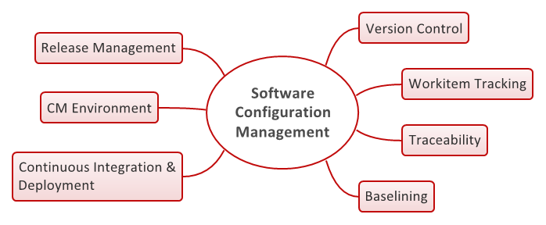

Slide 97
Best Maintenance Practices by Key Process Area
3. Category: Support
3. Process Area: Decision Analysis and Resolution
Best Practices for Software Maintenance:
Practice 29: Trade-off alternatives using value-based software engineering principles to help make decisions.
Practice 30: The software maintenance decisions to business goals and use business cases to weigh alternatives.

Slide 98
Best Maintenance Practices by Key Process Area
3. Category: Support
4. Process Area: Measurement and Analysis
Best Practices for Software Maintenance:
Practice 31: Establish a software measurement program whose aim is to gain insight into performance of people, processes, and projects relative to standards and benchmarks and assess the quality of products, processes, and services being generated during software maintenance

Slide 99
Best Maintenance Practices by Key Process Area
3. Category: Support
5. Process Area: Process and Product Quality Assurance
Best Practices for Software Maintenance:
Practice 32: Maintain the integrity of processes being used during software maintenance.
Practice 33: Assurance the quality of products being generated during software maintenance, including those associated with both the releases and the environment used to create it.

Slide 100
Best Maintenance Practices by Key Process Area
3. Category: Support
6. Process Area: Customer Support
Best Practices for Software Maintenance:
Practice 34: Create a website as soon as possible to keep customers/users informed, and keep it updated with current and useful information about releases during maintenance.

Slide 101
Best Maintenance Practices by Key Process Area
Practice 35: Provide high levels of customer support during operations and maintenance including user training, hand-holding, and query handling.
Practice 36: Provide prompt response to user requests via help desk staffed by those who can provide answers.

Slide 102
Best Maintenance Practices by Key Process Area
3. Category: Support
7. Process Area: Distribution Management
Best Practices for Software Maintenance:
Practice 37: Maintenance the integrity of the distribution process by assuring that the products delivered to the field are configured properly and work in customer sites.

Slide 103
6.3 The Role of Requirements
Separation of Work in Maintenance:
Project Role:
Release Planning and Production
Defect repairs and backlog reduction
Enhancements

Slide 104
6.3 The Role of Requirements
Core Role:
Sustaining engineering
Independent test and verification
Product support
Information assurance
Operations and facility support
Field support

Slide 105
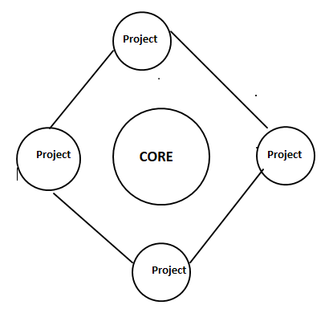
Separation of work in Maintenance

Slide 106
6.3 The Role of Requirements
Seven reasons for change requests:
1. Software trouble reports (STRs) that identify defects that must be fixed in the next release.
2. STRs that identify defects in the backlog that should be considered to be fixed in the next release

Slide 107
6.3 The Role of Requirements
3. System enhancement requests that add, subtract, or modify features and functionality that users want (new and changed requirements).
4. System enhancement requests to improve performance (memory usage, disk utilization, central processing unit (CPU) utilization, etc.) and usability in the field.

Slide 108
6.3 The Role of Requirements
5. Company change driven by interfaces with other systems, typically external.
6. Compatibility changes with platform (hardware, operating systems, etc.) and field site configurations (specialized drivers, platform variations, etc.)
7. Demands from senior management for improvements (These may take the form of enhancements or changes needed to provide performance.)

Slide 109
6.3 The Role of Requirements
Defects are separated by Priority:
1. Catastrophic (Showstopper)
2. Critical (Major)
3. Serious (High)
4. Annoyance (Medium)
5. Minimal (Minor)

Slide 110
6.4 Budgeting and Estimating
Maintenance organizations pay for their projects using budgets developed based on the number of changes scheduled to be incorporated into the next release.
Usually last year’s budget dictates this year’s expenditures.
If emergency funding for fixes needed they go to the project lead for additional funding on a fee-for-service basis.

Slide 111
6.5 Release Management - Schedule
Release Planning
Architecture analysis
Hardware defect repair
Software defect repair
Hardware enhancements
Software enhancements
Release integration and test
Release qualification and delivery

Slide 112
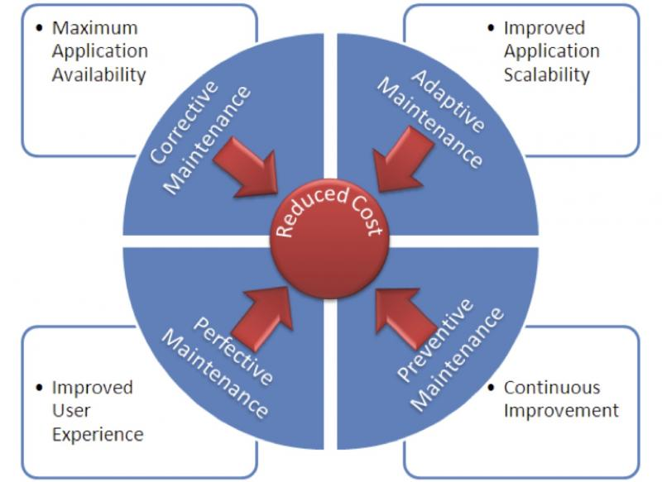

Slide 113
Evolution Engineering Domain-(SMM)
Predelivery and Transitions Services:
Maintainers influence during design phase
An SLA exists for the new software
Maintenance environment exists
Record of transition measures exist
Identify, and complete the documentation
Communicate status to the stakeholders

Slide 114
Operational Support Services
Support activities are recognized as value-added activities
Software Maintenance is organizing its evolution activities around it
Operations, development and maintenance activities are softened
Value added support activities are promoted – knowledge transfer activities.

Slide 115
Evolution and Correction Services
The authorized customer option is implemented
Requirements are documented any modifications are negotiated
Modifications are documented (tractability)
Regression tests are carried out
Communicate readiness-acceptance testing
Software is improved each time

Slide 116
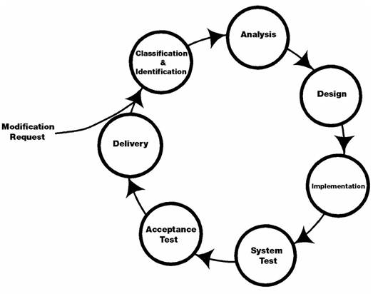

Slide 117
Verification and Validation
Techniques for V&V are adapted for maintenance
Follow the V&V procedures in maintenance context and by service type
Adequate regression testing is carried out for every maintenance release (MR)

